Slide 1
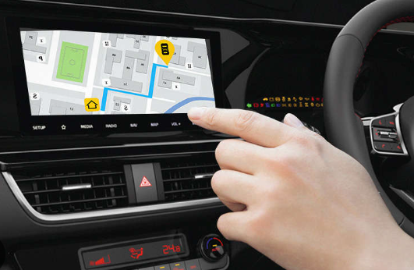
Echopilot – Voice-Assisted Navigation System

Slide 2
Project Overview
Objective:
To develop a web app for voice-assisted navigation.
Key Features:
- Voice input for origin and destination
- Audible navigation instructions
- Real-time location tracking
- Multilingual support

Slide 3

Technologies Used
Frontend: HTML, CSS, JavaScript
Mapping: Leaflet.js with OpenStreetMap
Routing: Leaflet Routing Machine
Voice: Web Speech API
Geocoding: Nominatim
Translation: Google Translate API

Slide 4
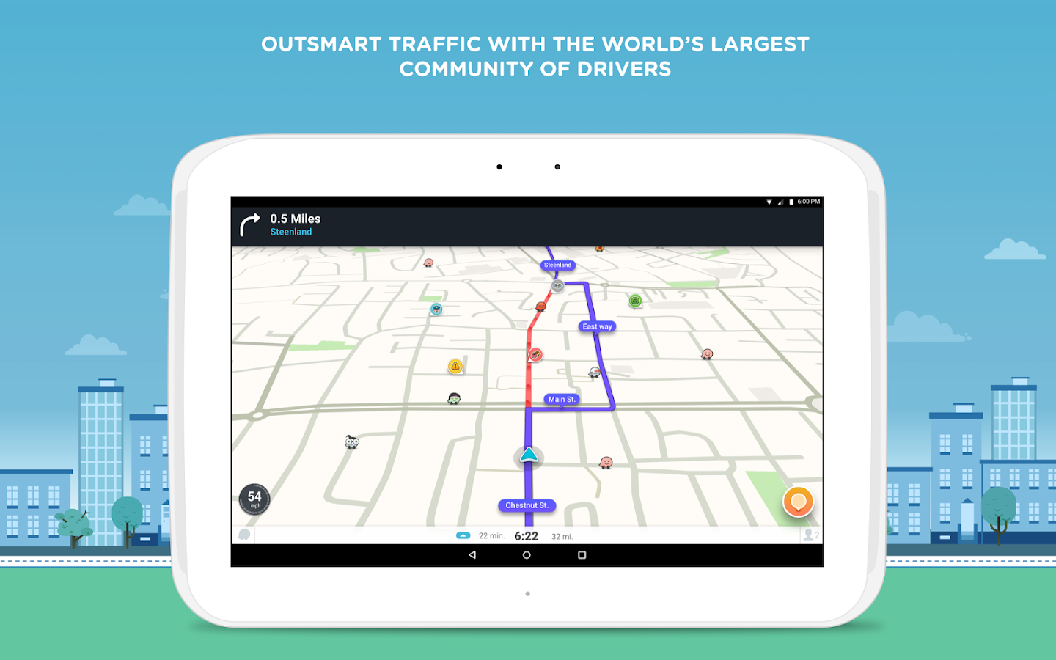
User Interface
Components:
Input fields
Voice input buttons
Map display
Voice settings
Language selection
This Photo by Unknown Author is licensed under CC BY-NC-ND

Slide 5
Voice Input Functionality
Process:
Click microphone icon
Speak location
Input auto-filled via speech-to-text
Reads out navigation steps.
Adjustable parameters:
Rate
Pitch
Voice selection
Functionality
Access user’s location
Display marker
-Auto-update position

Slide 6

Routing and Navigation
Process:
Get coordinates from Nominatim
Calculate route with OSRM
Display with Leaflet Routing Machine

Slide 7

Multilingual Support
Translate UI into multiple languages for accessibility.
This Photo by Unknown Author is licensed under CC BY-SA-NC

Slide 8




Use Cases
Visually impired users
Drivers
Tourists
Elderly

Slide 9


Future Enhancements
Planned Features:
Wearable device integration
Offline capabilities
Accent support
Feedback system

Slide 10
Conclusion
Echopilot offers seamless voice-controlled navigation using modern web technologies.
Can be used in multiple browsers

